Slide 1
Canvas
Instructions on Live Courses

Slide 2
For remote learning, the following are instructions on how to record online lectures through Canvas.
In summary:
Faculty will open the Canvas course and record their lectures using the Conferences tool. A link will be sent to the students to access the live recording. Once completed, faculty may then save the MP4 video onto their desktops to be placed in Camtasia at a later date.

Slide 3
Short Video tutorial on BigBlueButton for moderator/presenters

Slide 4
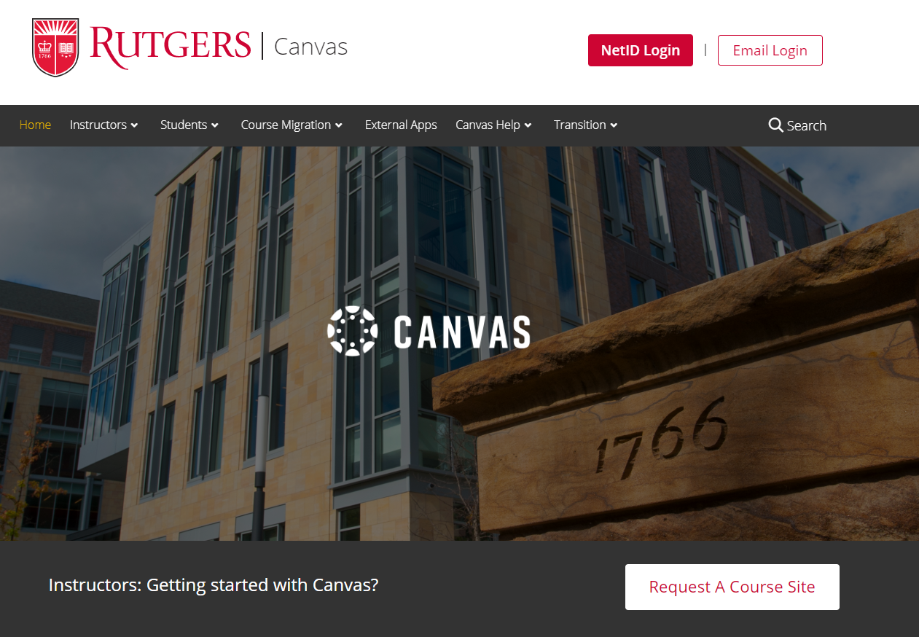
1. Go on Canvas.Rutgers.edu and enter your netID to login.

Slide 5
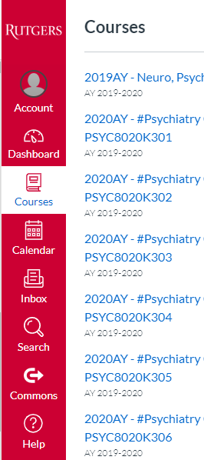
Click on Courses on the left side and select your course

Slide 6
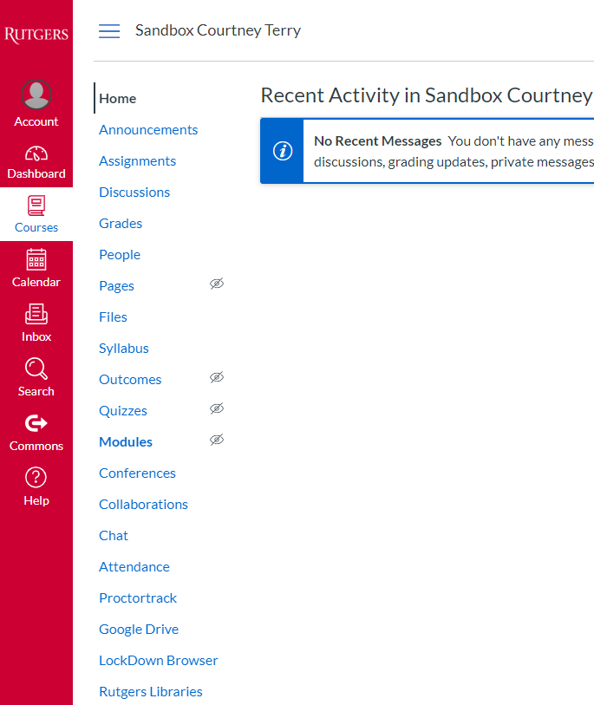
Click on Conferences
Click on Conferences

Slide 7
Click on + Conference shaded in blue:
This will allow you to add your new live conference.

Slide 8
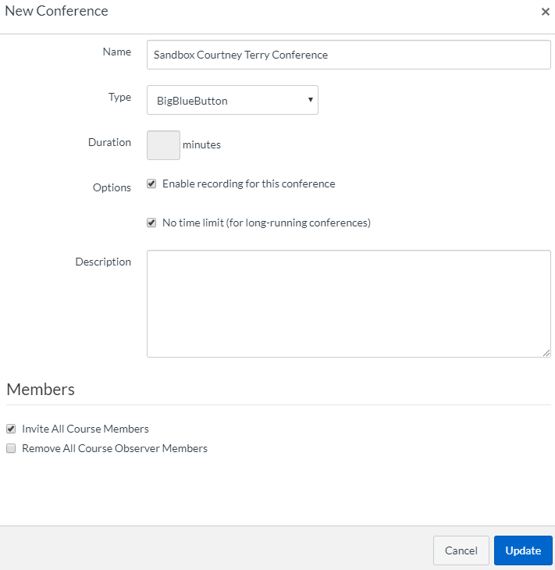
v
In the Name box type in the name of your Live Course
Check mark Enable Recording for this conference
*Check mark No time limit (for long-running conferences) *this will allow your session to run over the allotted time inputted in Duration section.
Description: feel free to add a description for your Live Course
Check mark: Invite All Course Members
Lastly: Click Update once done

Slide 9
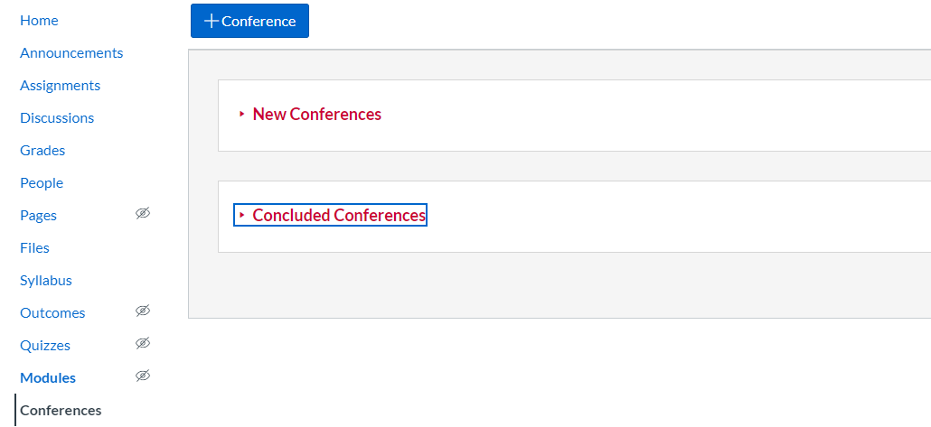
For New Conferences: Click on New Conferences

Slide 10
Click on Start under New Conferences

Slide 11
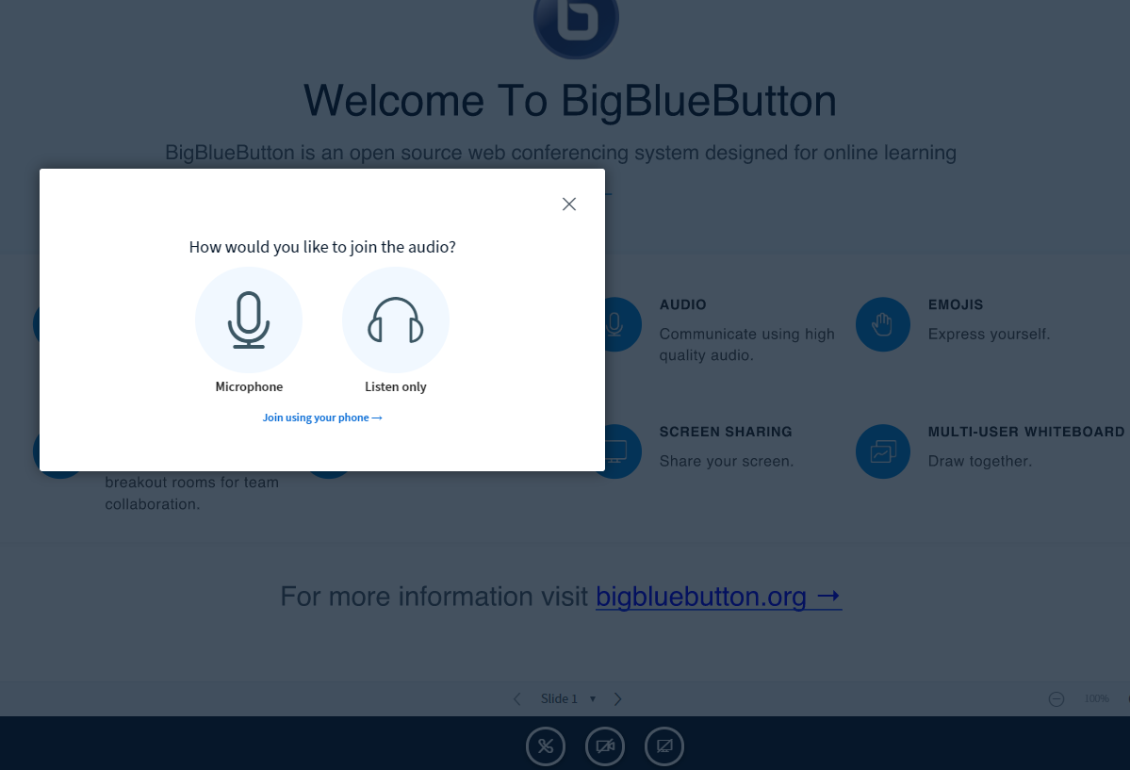
Click on Microphone
This will allow the presenter to speak into the microphone and listen as well.

Slide 12
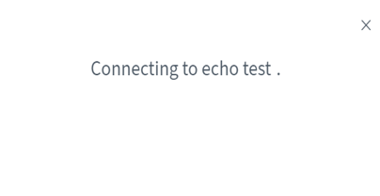
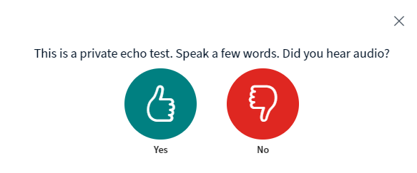
It will next Connect to echo test.
It will ask you if this is a private echo test. You may speak a few words in order to test your audio.
You can click yes if you hear audio clear, if no select the no button.

Slide 13
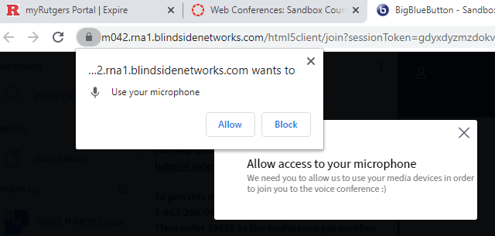
Click on Allow
You may be prompted to allow microphone access. If prompted, click on Allow.

Slide 14
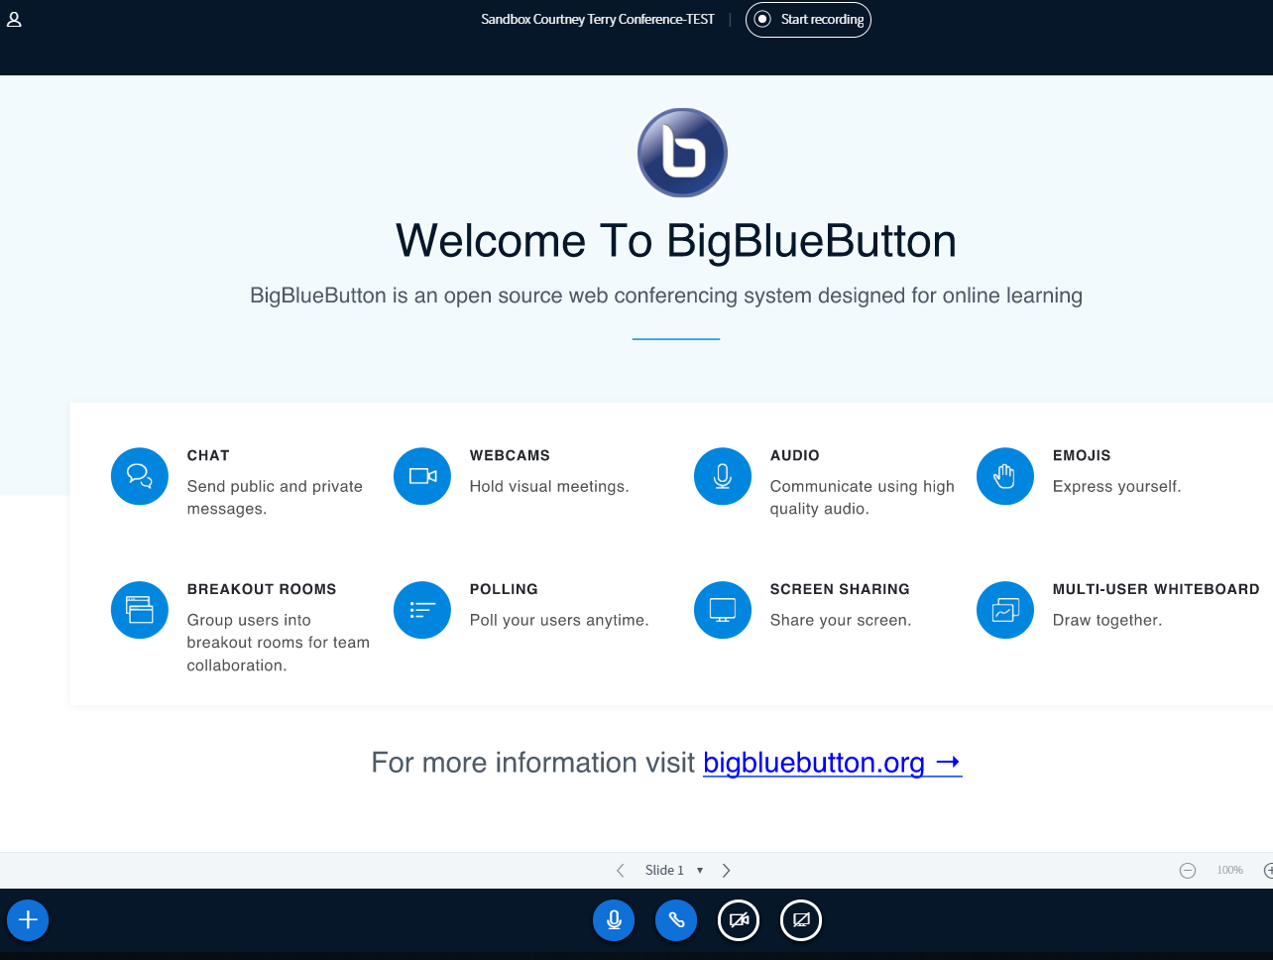
Click on Start recording
*Presenters sharing screens, please have your materials open prior to the start of your recording.
You may be prompted to allow microphone access. If prompted, click on Allow.

Slide 15
Clicking on the + symbol will allow you to :
Upload a presentation
Mute
button
Share
webcam (optional)
Click here to share your screen

Slide 16
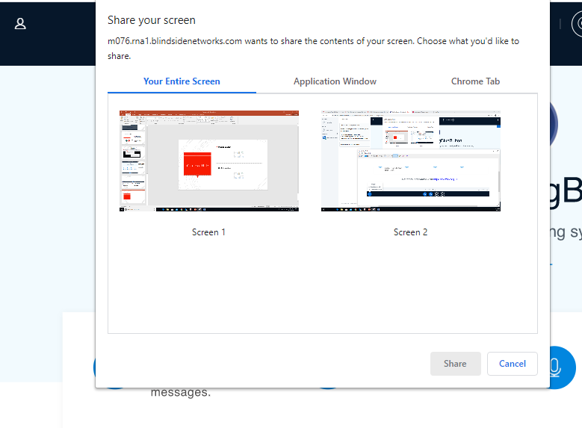
Share your screen:
Select the screen you would like to share.
Next: click on the share button below.

Slide 17
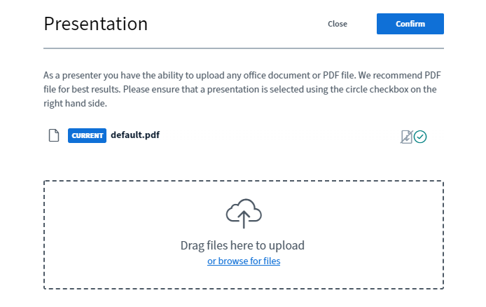
Uploading your presentation (optional)
Drag your file here from your desktop or you can browse for files

Slide 18
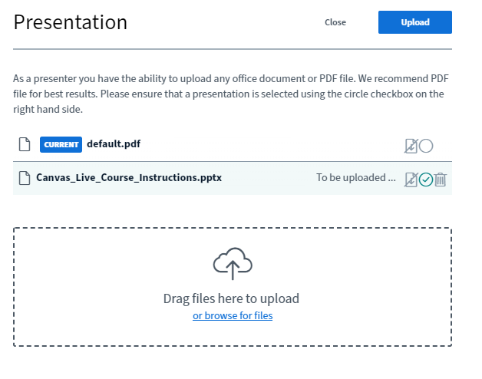
Uploading your presentation (optional)
Your uploaded document will be entered here.
Click on upload if done
You can delete by clicking here

Slide 19
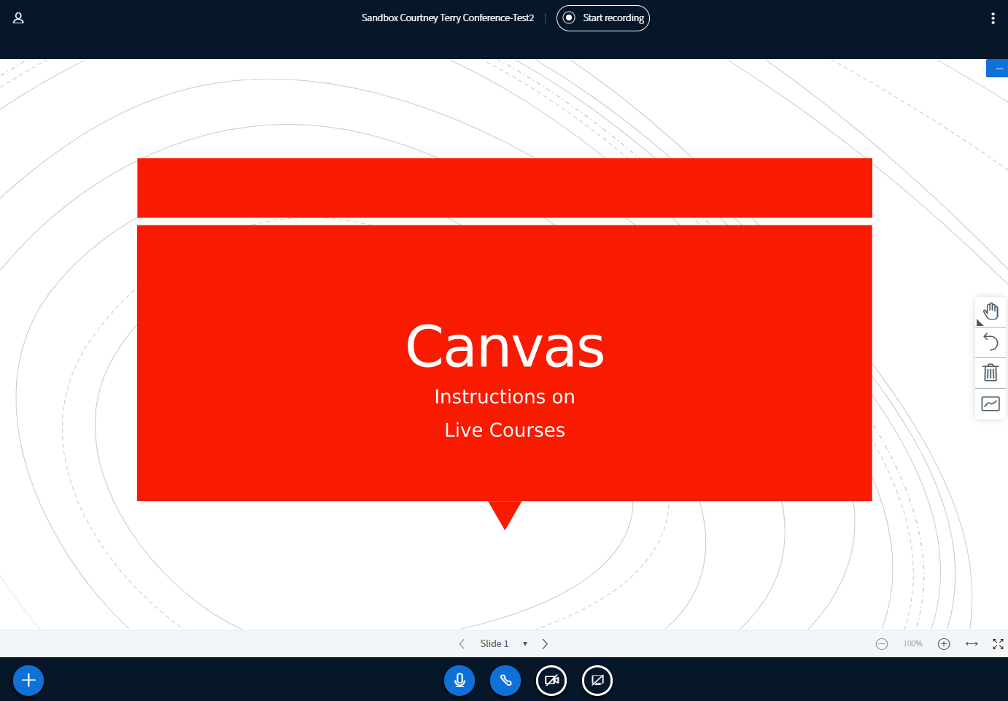
Once uploaded, you can start recording.

Slide 20
Instructions on how to download your video on desktop
Click on your recorded lecture listed under Concluded Conferences

Slide 21
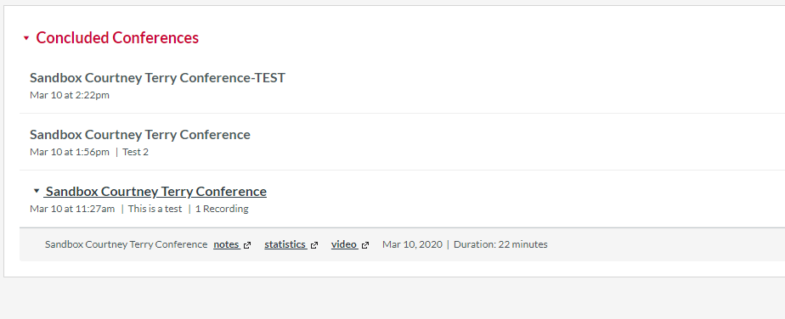
Click on the chevron to expand and
select video

Slide 22
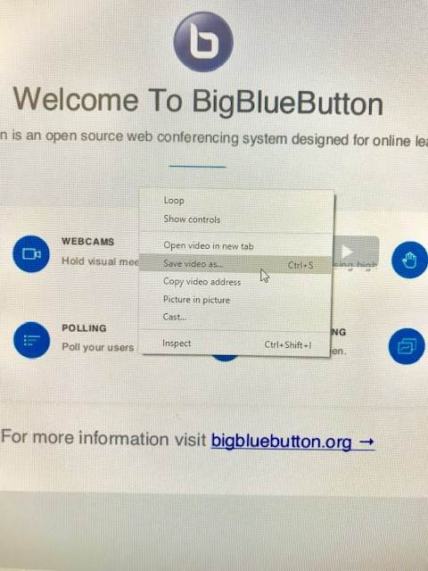
Right click on your mouse and click on Save video as ……..

Slide 23
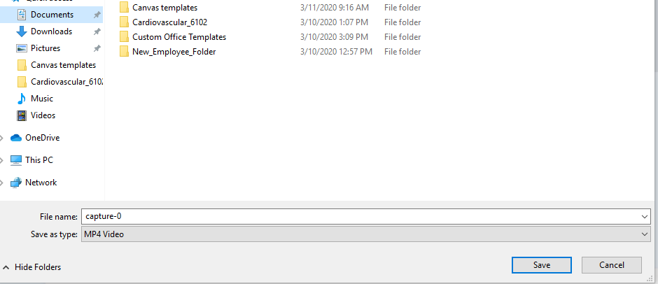
You may save your video into your desired folder and click the save button

Slide 24
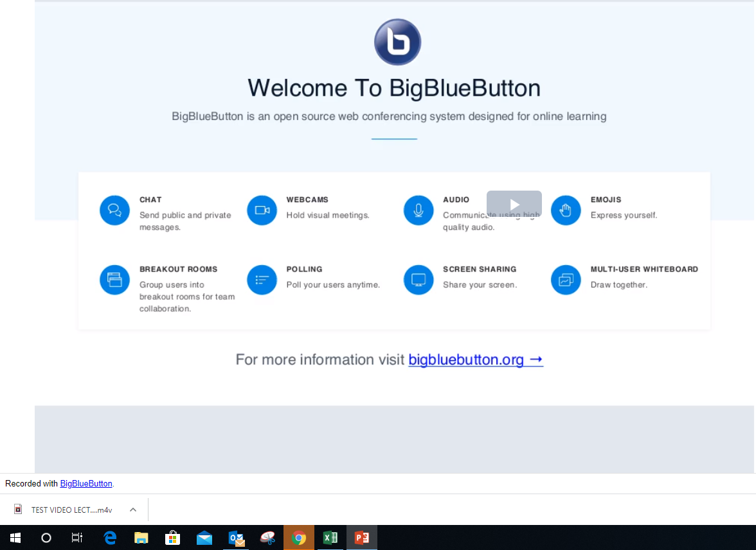
You may now look into your folder to ensure your video has been saved before closing the window.
Once completed, faculty may send the saved MP4 video for placement in Camtasia at a later date.

Slide 25
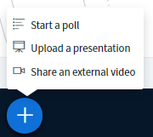
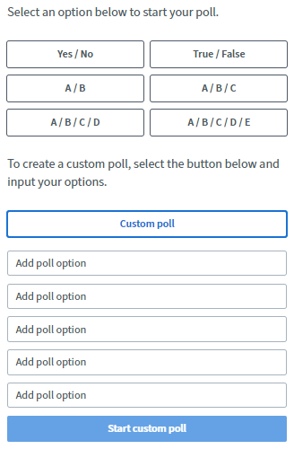
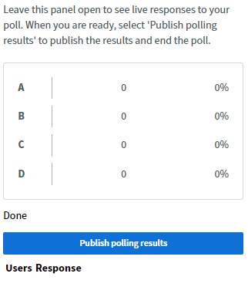
Polling Options
You can run a poll during your slides. Click on plus and then click on Start a poll
2. Select your poll option for display.
You can Custom poll if none of the above match your slide.
3. Click on Publish polling results when ready to display to students

Slide 26
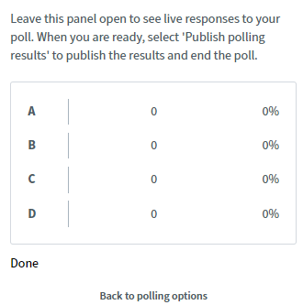
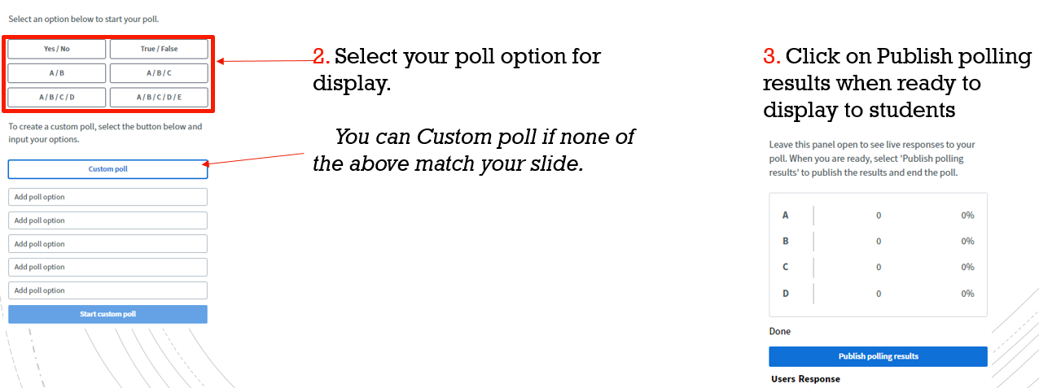
You can go to your next slide with question and click on Back to polling options and repeat steps 2 – 3.

